Slide 1
Velocity and tangents
We are going to look at two questions that, in appearance, have nothing to do with each other (one is geometrical, the other physical);
We will find out (not surprisingly if you admire Mathematics) that the answer to both questions involves the same mathematical concept and computation. (most of you already know what I am driving at)
Here are the two questions:

Slide 2
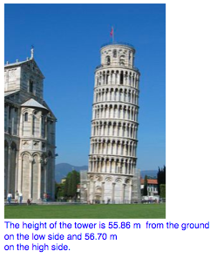
Q1. In the late 1580’s (so goes the story, maybe incorrect) Galileo astounded the authorities in Pisa by dropping two stones of quite different mass from the top of the tower of Pisa.

Slide 3
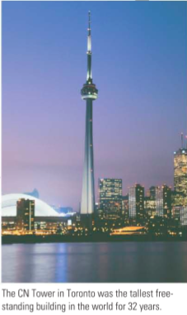
(see p. 47, example 3. The author is Canadian, the instructor is Italian and did his University studies in Pisa!)

Slide 4
The question is:
Q1a. When either stone hit the ground (in Pisa) how fast were they traveling?
Q1b. Which got there first?
(You should know the answer to Q1b !)
Here comes the second question:

Slide 5
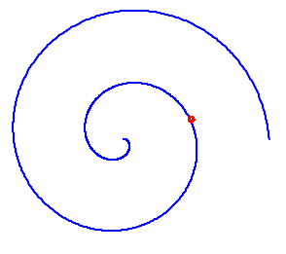
Q2. You have a nice looking curve in the plane, like this one:
Q2a. What do we mean by the tangent line at the red point?
Q2b. How do we find the equation of that line?

Slide 6
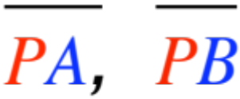
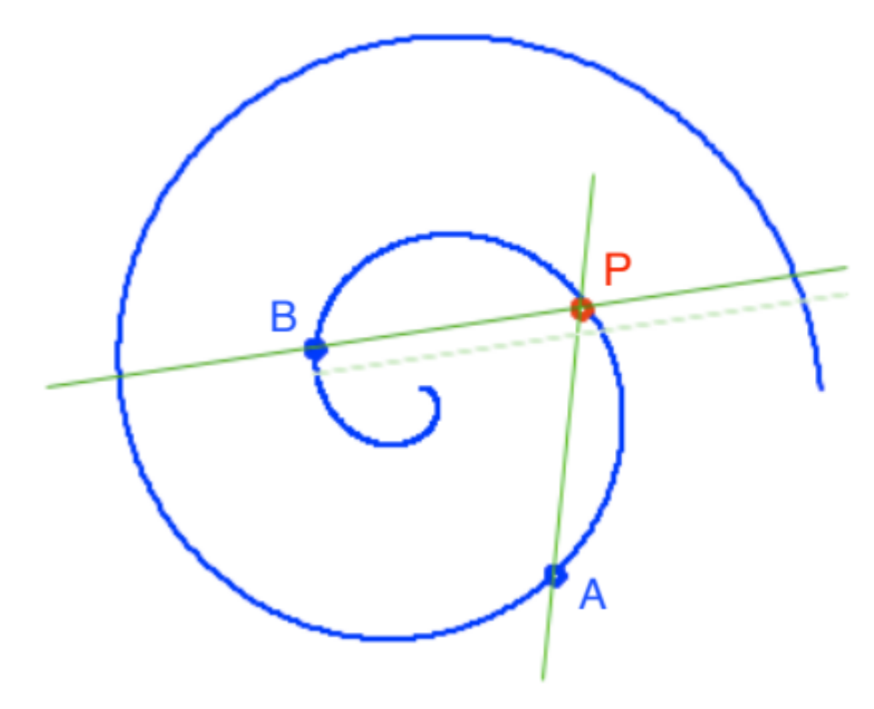
Once again, with a few centuries of thought, we give the following
Definition. The tangent line at P is the limiting position of the various secants ,…
as A and B get closer to P. Q2a is answered !

Slide 7
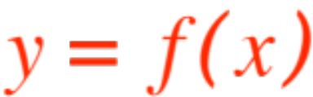
In order to answer Q2b we need to find a way of computing the equation of the tangent straight line.
If you ever will take courses in Linear Algebra and Differential Geometry you will learn how to find the equation of the tangent line for a spiral as shown.
However, if the curve in question is the graph of a funtion life gets easier.
Mostly because we can draw pictures !

Slide 8
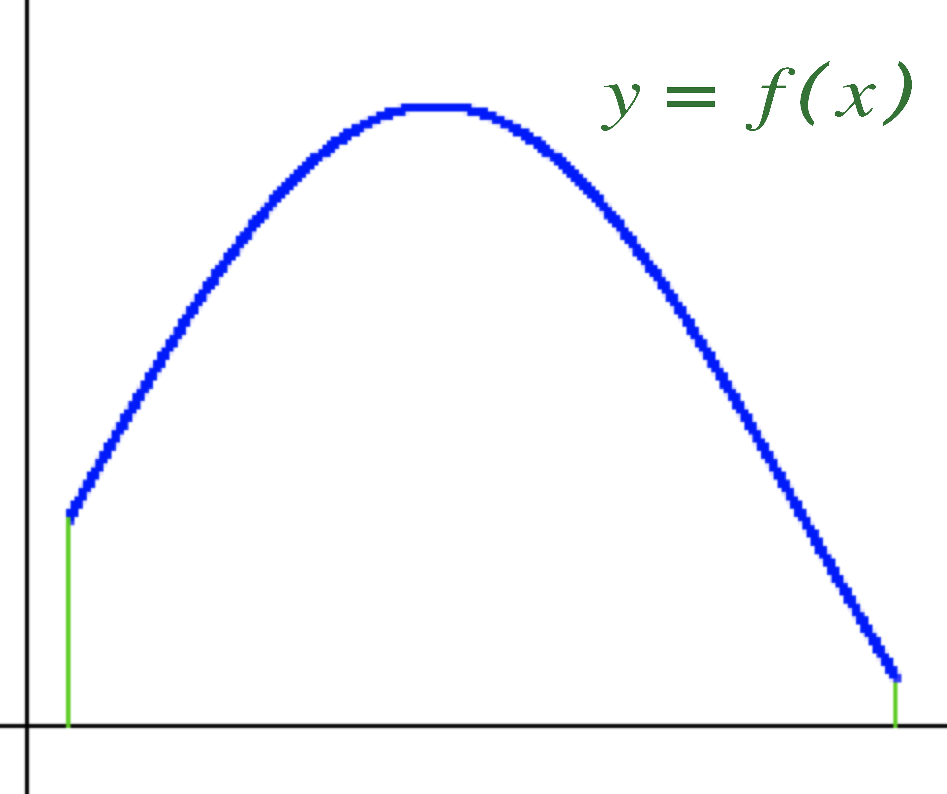
Here is the first one:
The next one has a fixed point P
and three secants.

Slide 9
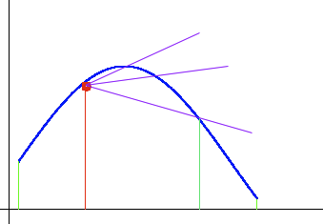

Slide 10
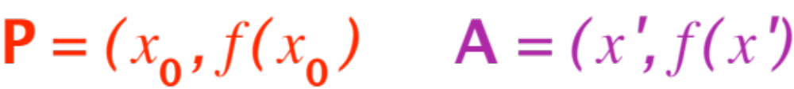
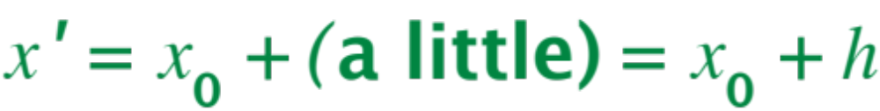
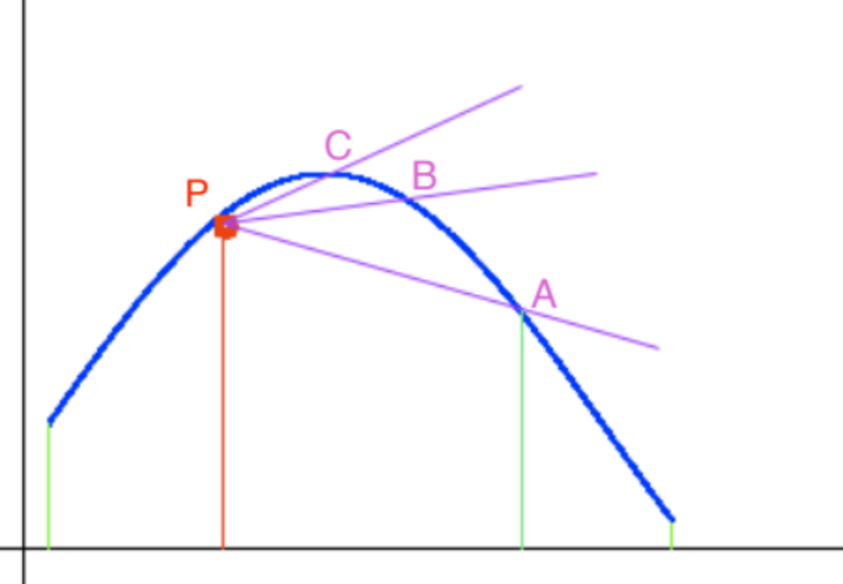
Now we give names and coordinates to various points, so we can work with them. We concentrate on P and A. We can write

Slide 11
Let’s get back to the definition for a second.
Definition. The tangent line at P is the limiting position of the various secants ,…
Ask yourselves: among the (infinitely many) lines going through P, how do we identify any particular one?
One minute’s thought and the answer is:
via the slope!
So here is our prescription for finding the tangent at P:

Slide 12

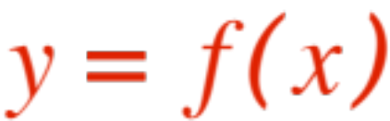
Find the formula for the slope of a secant through P. (Something from A will appear.)
Change that something so that A gets closer and closer to P, see what happens to the formula (take a limit). That’s the slope you are looking for.
Use the point-slope form of the equation of a line (you know P and now you know the slope) to get your answer.
Let’s follow the steps in our situation

Slide 13
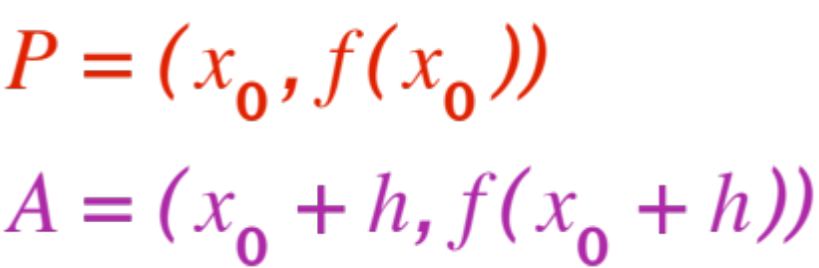
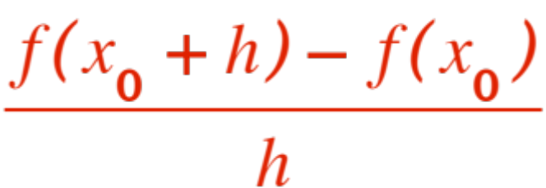
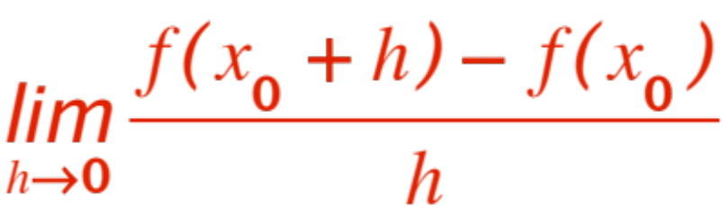
(the “something from A” is h !)
The slope of is (remember rise/run ?)
Now compute the limit (to be learned yet!)
(Anyway, take various smaller and smaller values of h compute the quotient, then guess!)
WE CAN COMPUTE TANGENTS !!!

Slide 14
VELOCITY
Back to our friend Galileo dropping stones from the top of the leaning tower (low side !)

Slide 15

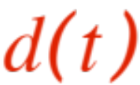
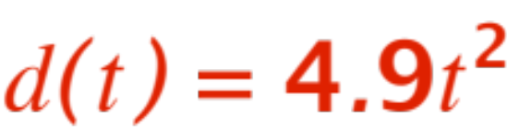
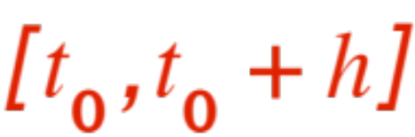

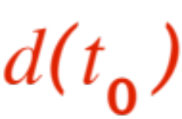
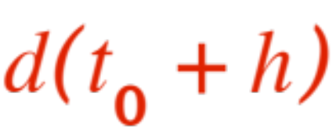

A little knowledge of Physics (or Wikipedia, just go to
http://en.wikipedia.org/wiki/Equations_for_a_falling_body)
shows that seconds after leaving Galileo’s hand the stone has traveled meters, where
Over a time interval the stone has dropped (in seconds !) from
meters away from Galileo’s hand to
meters away from Galileo’s hand
The stone’s average velocity is therefore

Slide 16

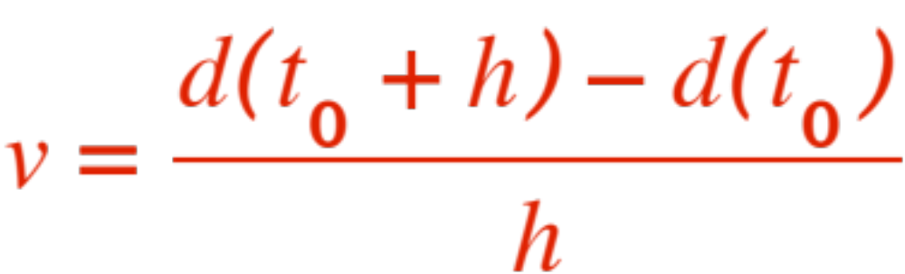

(over THAT time interval !, it will change if you change or )
the same kind of quotient we had before !
If we let and see what happens to the quotient we get the notion of
Instantaneous velocity at time
Question Q1a asked how fast the stone was going when it hit the ground. If we knew at that time

Slide 17

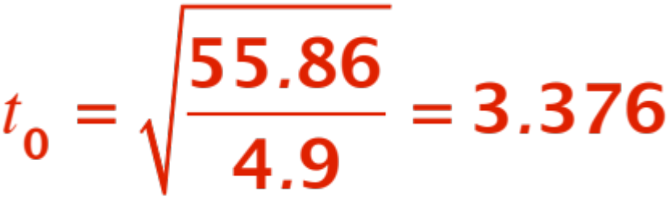
(that is, if we knew how many seconds it took the stone to hit the ground) we could apply the same three steps as in the tangent problem and get our answer. But we DO know how long it takes the stone to get down! It has to travel 55.86 m and the equation (wikipedia!) is
When my cheap TI30 tells me that
We go for the three steps. We look at the ratio

Slide 18
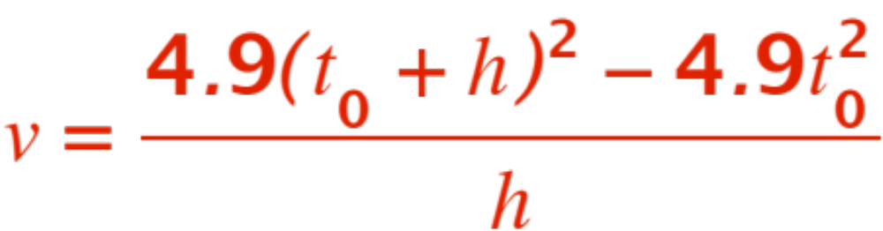
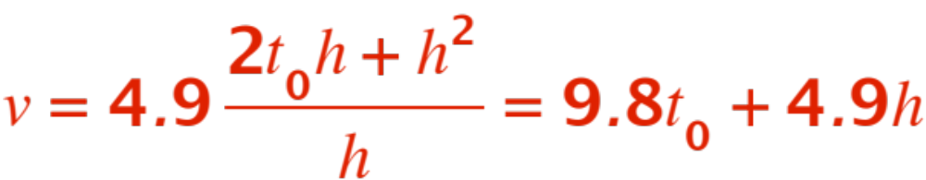

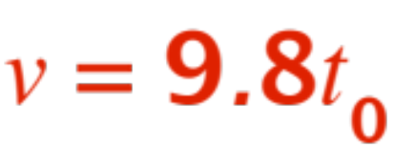
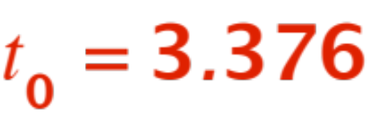

(we leave alone until the end, we just know what it is) we get
A little 7-th grade algebra tells us that
And if shrinks to , it’s easy to see we get
NOW! we let and get (TI30 !)

